Slide 1
C++ for Advanced Mathematical Finance lecture 3
Simon Hartley

Slide 2
Introduction – SYLLABUS
Programming in C++
Pointers
Templates
STL Classes

Slide 3
OOP – Pointers
When we declare an object of the class
Symbol | Name | Description
& (ampersand sign) | Address operator | Determine the address of a variable.
∗ (asterisk sign) | Indirection operator | Access the value of an address.

Slide 4
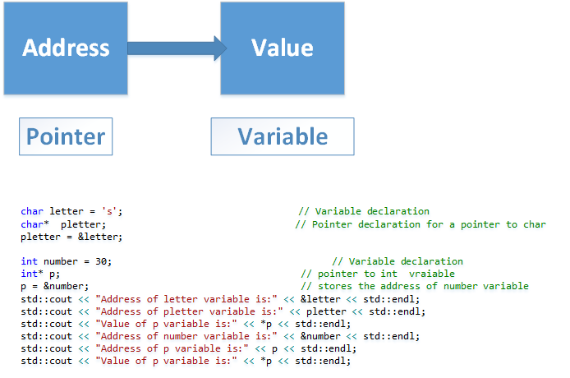
OOP – Pointers
When we declare an object of the class

Slide 5
OOP – Pointers
int var{100}, * varPoint;
varPoint = var;// Wrong!
// varPoint is an address but var is not
*varPoint = &var;// Wrong!
// &var is an address
// *varPoint is the value stored in &var
varPoint = &var;// Correct
// varPoint is an address as is &var
*varPoint = var; // Correct
// both *varPoint and var are values

Slide 6
OOP – Pointers
char letter = 's'; // Variable declaration Makes a new object. The new object is to be an char
char* pletter; // Pointer declaration for a pointer to char could have any value at all. The new object is to be an char-pointer
pletter = &letter; // stores the address of letter variable
int number = 30; // Variable declaration Makes a new object. The new object is to be an int.
int* p; // Make a new object. The new object is to be an int-pointer
p = &number; // stores the address of number variable
std::cout << "Address of letter variable is:" << &letter << std::endl;
std::cout << "Address of pletter variable is:" << pletter << std::endl;
std::cout << "Value of p variable is:" << *p << std::endl;
std::cout << "Address of number variable is:" << &number << std::endl;
std::cout << "Address of p variable is:" << p << std::endl;
std::cout << "Value of p variable is:" << *p << std::endl;
// We declare objects as before
Student aStudent; // Variable declaration
Student* ptoaStudent; // Pointer declaration for a pointer to Student
ptoaStudent = &aStudent;

Slide 7
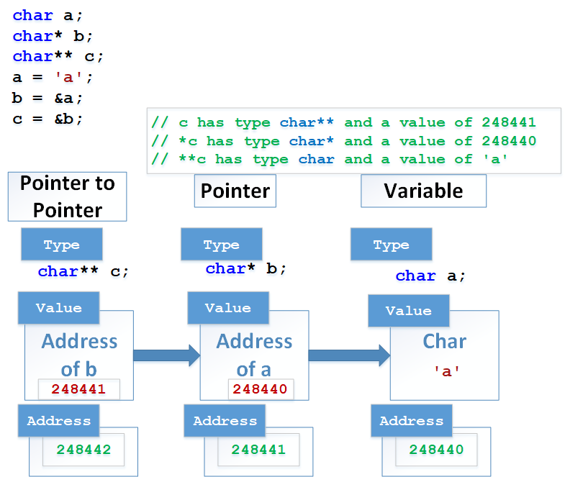
OOP – Pointers

Slide 8
OOP – Classes in C++
Simple Class Example:
class Person {
public :
std::string strName;
double height_m;
double weight_kg;
int iAge;
double CalculateBMI(void) {
return weight_kg / (height_m * height_m);
}
};
int main(void) {
Person aPerson ; // an instance of the class
aPerson.strName = " Person";
aPerson.iAge = 18;
}

Slide 9
OOP – Data Abstraction and encapsulation
class Person {
public:
double CalculateBMI (void);
private:
std::string strName;
double height_m;
double weight_kg;
int iAge;
};

Slide 10
OOP – Inheritance
Person
std::string strName;
Is a
I
Student
Teacher

Slide 11
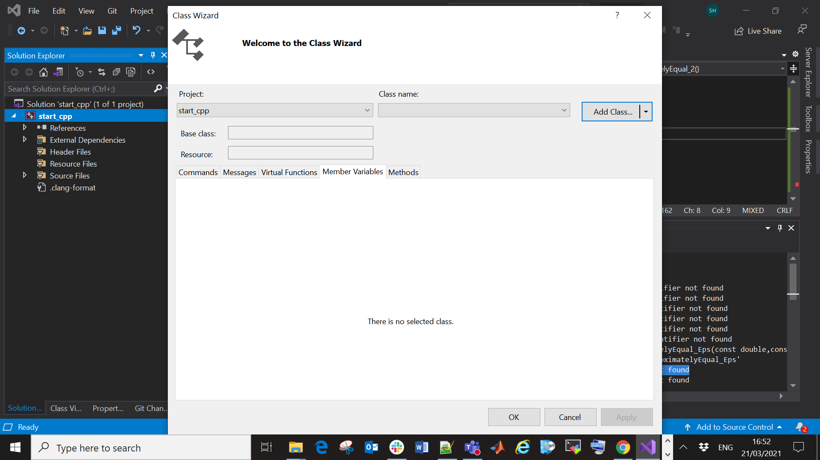
OOP – Classes and File organisation

Slide 12
OOP – Encapsulation
Encapsulation is the technical term for wrapping data and functions into one object. The keywords public, protected and private are critical for access control.
Modifier | Who has access
public | Everyone has access
protected | Only objects from the base and from derived classes
private | Only objects from the base class

Slide 13
OOP – References Pointers
We have introduced References and Pointers to simple data types before:
double x = 2.0;
double & ref = x; // A ref to x
double * ptr = &x; // A pointer to x
In functions, passing by reference can be faster. The reference should be declared constant if you do not intend to modify the data (to prevent accidental modifications and ensure readability of the code.):
void SetName( const std::string & name ){
strName = name
}

Slide 14
OOP – References Tips
The following general rules of thumb help to make our code robust and efficient
Make all complex data types that are input in functions references
Declare variables (including references) const if you do not intend them to be modified
Declare member functions const if they do not change member variables

Slide 15
OOP – References Tips
References and pointers to objects pretty much work in the same way as pointers or references to simple data types (double, int etc)
Person aPerson (" Elizabeth ", 1.7 , 67, 29);
Person & aRefToAPerson = aPerson ;
std::cout<<" Name is: " << aRefToAPerson.GetName();
Student * aPointerToAStudent = & aStudent ;
std::cout<<" Name is "<<(*aPointerToAStudent).GetName();

Slide 16
OOP – References Tips
Note that we need the brackets around the dereferenced
Pointer *aPointerToAStudent;
There is a shortcut combining the dereference-operator
and the dot-operator:
std::cout<<"Name is "<< aPointerToAStudent->GetName();

Slide 17
OOP – References Tips
The following works:
Person & anotherReference = aStudent ;
Person * aPointerToAStudent = & aStudent ;
std::cout<<" Name is " <<
(* aPointerToAStudent).GetName ();
Note that we can only access members of Person as type is Person *
std::cout<<"Name is"<<aPointerToAStudent->GetName();

Slide 18
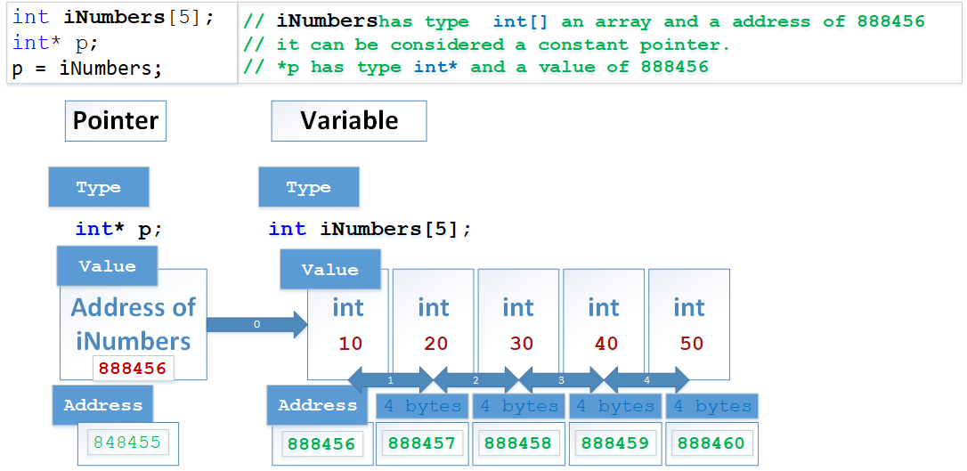
OOP – Pointers

Slide 19
C++ – Array Pointer arithmetic
int iNumbers[5];
int* p;
p = iNumbers; // assign p the address of iNumbers
*p = 10; // deref and assign iNumbers[0]=10
p++; // move to next iNumbers[1]
*p = 20; // iNumbers[1]=20
p = &iNumbers[2]; // assign address iNumbers[2] to p
*p = 30; // deref and assign value 30
p = iNumbers + 3; // by + for address iNumbers[3]
*p = 40;
p = iNumbers;
*(p + 4) = 50;
for (int n = 0; n < 5; n++)
cout << iNumbers[n] << ", "; // output:10 20 30 40 50

Slide 20
C++ – Array Pointer Passing
We can declare pass array pointers to functions
double getAverage(int arr[], int size) { … }
double getAverage1(int arr[5]) { … }
double getAverage2(int *arr, int size) {… }

Slide 21
C++ – Array Pointer 2D
We can declare a 2 Dimensional array:
int a[5][5] = {
{ 1, 2, 3, 4, 5 }, // initializers for row indexed by 0
{ 6, 7, 8, 9,10 }, // initializers for row indexed by 1
{ 11,12,13,14,15 }, // initializers for row indexed by 2
{ 16,17,18,19,20 }, // initializers for row indexed by 3
{ 21,22,23,24,25 } // initializers for row indexed by 4
};

Slide 22
C++ – Array Pointer 2D Passing
void display(int n[][5]) {
cout << __func__ << std::endl;
cout << "2D Array Values: " << endl;
for (size_t i = 0; i < 5; ++i) {
for (size_t j = 0; j < 5; ++j) {
cout << "num[" << i << "]["
<< j << "]: " << n[i][j] << endl;
}
}
}
void display1(int(*array1)[5], size_t rows) {
cout << "2D Array Values: " << endl;
for (size_t n = 0; n < rows; n++) {
for (size_t m = 0; m < 5; m++){
cout << array1[n][m] << ", ";
}
cout << std::endl;
}
}

Slide 23
C++ – Array Pointer 2D Passing
void display2(int n[5][5]) {
cout << __func__ << std::endl;
cout << "2D Array Values: " << endl;
for (size_t i = 0; i < 5; ++i) {
for (size_t j = 0; j < 5; ++j) {
cout << "num[" << i
<< "][" << j << "]: "
<< n[i][j] << endl;
}
}
}

Slide 24
C++ – void Pointer
void pointer is a generic pointer that is used when we don't know the data type of the variable that the pointer points to.
void* ptr;
float f = 2.3f;
// assign float address to void pointer
ptr = &f;

Slide 25
C++ – Function Pointer
We can declare a non-constant pointer to a normal variable, it is also possible to declare a non-constant pointer to a function.
// fcnPtr is a pointer to a function that
// takes no arguments and returns an integer
int (*fcnPtr)();

Slide 26
C++ – Function Pointer
We can then dereference the pointer to call the function:
// function operation calls the function
int operation (int x, int y, int *functocall)(int,int)){
int g;
g = (*functocall)(x,y); // <- call function
return (g);
}

Slide 27
// Addition function
int addition (int a, int b){
return (a+b);
}
// Subtraction
int subtraction (int a, int b){
return (a-b);
}
// function operation calls the function
int operation (int x, int y, int (*functocall)(int,int)){
int g;
g = (*functocall)(x,y);
return (g);
}
int main (){
int m,n;
int (*minus)(int,int) = subtraction;
m = operation (7, 5, addition); // use the function name
n = operation (20, m, minus); // pass a function ptr
cout << n;
return 0;
}

Slide 28
C++ – dynamic memory
C++ allows us to allocate the memory of a variable or an array in run time. This is known as dynamic memory allocation.
The new operator allocates memory to a variable. It returns the address of the memory location.
Once we no longer need to use a variable that we have declared dynamically, we can deallocate the memory occupied by the variable.For this, the delete operator is used. It returns the memory to the operating system. This is known as memory deallocation.

Slide 29
// declare an int pointer
int* pointVar;
// declare a float pointer
float* pointFloat;
// dynamically allocate memory using the new keyword
// Notice that we have used the pointer pointVar to allocate the memory dynamically.
// This is because the new operator returns the address of the memory location.
pointVar = new int; pointFloat = new float;
// assigning value to the memory
*pointVar = 45; *pointFloat = 45.45f;
cout << *pointVar << *pointFloat << endl;
// Once we no longer need to use a variable that we have declared dynamically,
// we can deallocate the memory occupied by the variable.
// For this, the delete operator is used.It returns the memory to the operating system.
// This is known as memory deallocation.
delete pointVar;
delete pointFloat;
C++ – new Pointer

Slide 30
C++ – dynamic memory
a memory leak occurs. When we have allocated memory but not used memory deallocation.
#include <iostream>
using namespace std;
void oil_leak() {
// a function to allocate 8 memory from the heap for a pointer. If you are using a 64 - bit machine, this will use 8 bytes.
double *pointer = new double(32.54);
// allocate but with new but not deleted
}
int main() {
// 8 bytes does not seam like a big leak until...
for(int j = 0; j < 150000; j++) {
oil_leak();
}
}

Slide 31
C++ – new Pointer
int num;
cout << "Enter total number of students: ";
cin >> num;
float* ptr;
// memory allocation of num number of floats
ptr = new float[num];
cout << "Enter Marks of students." << endl;
for (int i = 0; i < num; ++i) {
cout << "Student" << i + 1 << ": ";
cin >> *(ptr + i);
}
cout << "\nDisplaying Score of students." << endl;
for (int i = 0; i < num; ++i) {
cout << "Student" << i + 1 << " :" << *(ptr + i) << endl;
}
// ptr memory is released
delete[] ptr;

Slide 32
C++ – Smart Pointers
Smart pointer | Best used when
std::unique_ptr | You don’t need to hold multiple references to a single object
std::shared_ptr | You need to hold multiple references to a single object
std::weak_ptr | You need to hold multiple references to a single object but don’t want to deallocate the object

Slide 33
C++ – Smart Pointers
The in SmartPtr.cpp demonstrates the following essential steps for using smart pointers.
Declare the smart pointer as an automatic (local) variable. (Do not use the new or malloc expression on the smart pointer itself.)
In the type parameter, specify the pointed-to type of the encapsulated pointer.
Pass a raw pointer to a new-ed object in the smart pointer constructor. (Some utility functions or smart pointer constructors do this for you.)
Use the overloaded -> and * operators to access the object.
Let the smart pointer delete the object.
For more Info see:
https://docs.microsoft.com/en-us/cpp/cpp/smart-pointers-modern-cpp?view=msvc-160

Slide 34
C++ – Smart Pointers
// When using the std::unique_ptr smart pointer,
// you can only assign one owner for the pointer behind the wrapper.
// The object the std::unique_ptr points to is deleted automatically when the smart pointer leaves the scope.
unique_ptr<int> p1(new int(365));
//unique_ptr<int> p2 = p1; // error E1776
// Using the std::shared_ptr smart pointer means
// you can apply multiple owners to a single raw pointer.
// All of the owners must also leave the scope for it to be deleted.
shared_ptr<int> p3(new int);
//shared_ptr smart pointer can also be used for reference counting.
// It contains an internal counter which tracks the amount of owners not yet destroyed.
// To check how many pointers lead to the same address, use the use_count() method:
cout << p3.use_count() << endl;
// in C++ pointers can form a referential loop by the
// last object in the reference chain points to the first one
// e.g. X->Y->Z->X
std::shared_ptr<char> p_shared = std::make_shared<char>(15);
std::weak_ptr<char> p_weak1(p_shared);
std::weak_ptr<char> p_weak2(p_weak1);
// Both std::weak_ptr and std::shared_ptr smart pointers will point to the same data.
// However, the std::weak_ptr will not change the value of the internal counter
// and hence take part in reference counting.
// One more reason to use std::weak_ptr for C++ memory management is that it helps
// with dangling pointers(those that point to deleted data).
// You can check if a particular piece of data is valid by using lock() or expired():
if (auto tmp = p_weak1.lock())
std::cout << *tmp << '\n';
else
std::cout << "Sorry, weak1 is no longer valid!\n";
if (auto tmp = p_weak2.lock())
std::cout << *tmp << '\n';
else
std::cout << "Sorry, weak2 is no longer valid!\n";

Slide 35
C++ – Function Templates
Consider function:
and
int max(int x, int y){
return (x > y) ? x : y;
}
double max(double x, double y){
return (x > y) ? x : y;
}

Slide 36
C++ – Function Templates
Function templates are functions that serve as a pattern for creating other similar functions.
The concept of function templates is to create a function without having to specify the exact type(s) of some or all of the variables. Instead, we define the function using placeholder types, called
template type parameters.
Usually denoted by T, U, S etc.

Slide 37
OOP – Function Templates
Here T is a placeholder type.
Note: function argument passed in for type T could be a class type, it would be better to make the parameters and return types of our templated function const references:
template <typename T> // this is the template parameter declaration
T Max(T a, T b) {
return a < b ? b : a;
}

Slide 38
OOP – Function Templates
template <typename T> // the template parameter declaration
inline T const& Max(T const& a, T const& b) {
return a < b ? b : a;
}
int main() {
int i = 39; int j = 20;
cout << "Max(i, j): " << Max(i, j) << endl;
double f1 = 13.5; double f2 = 20.7;
cout << "Max(f1, f2): " << Max(f1, f2) << endl;
string s1 = "Hello"; string s2 = "World";
cout << "Max(s1, s2): " << Max(s1, s2) << endl;
return 0;
}

Slide 39
OOP – Class Templates
If we have two or more classes which are almost identical we can write a single class template.
template <template parameter list>
template <class T> is a placeholder type.
Can have multiple via a comma separated list.

Slide 40
template <class T>
class pairs {
public:
pairs(T first, T second) {
a = first; b = second;
}
T getmax();
private:
T a, b;
};
template <class T>
T pairs<T>::getmax(){
T retval;
retval = a > b ? a : b;
return retval;
}
int main() {
pairs <int> myobject(100, 75);
cout << myobject.getmax();
return 0;
}

Slide 41
template<class T, class U>
class A {
T x;
U y;
public:
A() {
cout<<"Template Class Constructor Called:";
cout<<" x: "<< type_name<decltype(x)>();
cout<<" y: "<< type_name<decltype(y)>()<<endl;
}
};
int main() {
A<char, char> a;
A<int, double> b;
return 0;
}

Slide 42
STL – Standard Template Library
Containers
Containers are used to manage collections of objects of a certain kind Containers are like vector, list, deque, map and others.
Algorithms
Algorithms act on containers. They provide the means by which you will perform initialization, sorting, searching, and transforming of the contents of containers.
Iterators
Iterators are used to step through the elements of collections of objects. These collections may be containers or subsets of containers.

Slide 43
STL – Vector 2D Example
typedef vector< vector<int> > Matrix;
Matrix m = {
{ 1, 2, 3, 4, 5 },// initializers for row 0
{ 6, 7, 8, 9, 10 },// initializers for row 1
{ 11, 12, 13, 14, 15 },// initializers for row 2
{ 16, 17, 18, 19, 20 },// initializers for row 3
{ 21, 22, 23, 24, 25 } // initializers for row 4
};

Slide 44
STL – Vector 2D Example
void print(Matrix& mat){
const int m = static_cast<int>(mat.size());
const int n = static_cast<int>(mat[0].size());
for(int i=0; i<m; ++i) {
for (int j = 0; j < n; ++j) {
cout << mat[i][j] << " ";
}
cout << endl;
}
cout << endl;
}

Slide 45
STL – Rand Example
You can use the rand() function to generate random numbers.
But If you do not use the srand method together with rand, you will get the same sequence every time code runs.
To avoid the repetitive sequence, you must set the seed as an argument to the srand() method.
A very useful tip to make C++ generate random numbers is to use the time() method.
By seeding the generator with the same number, you are more likely to get the same random number each time.

Slide 46
STL – Rand Example
#include <cstdlib>/* srand, rand */
#include <ctime>
#include <iostream>
using namespace std;
int main (){
int iSecret, iGuess;
// initialize random seed:
srand((unsigned) time(0));
// generate secret number between 1 and 10:
iSecret = (rand() % 10) + 1;
do {
cout<< ("Guess the number (1 to 10): ");
cin>>iGuess;
if (iSecret<iGuess) {
cout<< ("The secret number is lower");
}else if (iSecret>iGuess){
cout<< ("The secret number is higher");
}
} while (iSecret!=iGuess);
cout<<"Congratulations!";
return 0;
}

Slide 47
STL – date time Example
The tm structure is very important while working with date and time in either C or C++. This structure holds the date and time in the form of a C structure:
struct tm {
int tm_sec; // seconds of minutes from 0 to 61
int tm_min; // minutes of hour from 0 to 59
int tm_hour; // hours of day from 0 to 24
int tm_mday; // day of month from 1 to 31
int tm_mon; // month of year from 0 to 11
int tm_year; // year since 1900
int tm_wday; // days since Sunday
int tm_yday; // days since January 1st
int tm_isdst; // hours of daylight savings time
}

Slide 48
STL – date time Example
#include <iostream>
#include <ctime>
using namespace std;
int main() {
// current date/time based on current system
time_t now = time(0);
cout<<"Number of sec since January 1,1970 is: "<<now<<endl;
tm* ltm = localtime(&now);
// print various components of tm structure.
cout << "Year:" << 1900 + ltm->tm_year << endl;
cout << "Month: " << 1 + ltm->tm_mon << endl;
cout << "Day: " << ltm->tm_mday << endl;
cout << "Time: " << 5 + ltm->tm_hour << ":";
cout << 30 + ltm->tm_min << ":";
cout << ltm->tm_sec << endl;
}

Slide 49
STL – Algorithms
Using STL algorithms is good for:
Maintainability: The names of the algorithms already state in a straightforward manner what they do. Explicit loops are rarely both better to read and as data-structure agnostic as standard algorithms.
Correctness: The STL has been written and reviewed by experts, and used and tested by so many people that you are pretty unlikely to reach the same degree of correctness when re-implementing the complex parts of it.
Efficiency: STL algorithms are, by default, at least as efficient as most handcrafted loops

Slide 50
STL – Algorithms
Showing all STL algorithms would be a very long there is already a very good and complete C++ reference publicly available
and is available for online viewing at:
http://cppreference.com
It can also be downloaded for offline viewing.

Slide 51
STL – Algorithms
https://en.cppreference.com/w/cpp/algorithm
Non-modifying sequence operations
Defined in header <algorithm>
all_of any_of none_of (C++11)(C++11)(C++11) | checks if a predicate is true for all, any or none of the elements in a range (function template)
for_each | applies a function to a range of elements (function template)

Slide 52
STL – ofstream, fstream
ofstream - represents the output file stream and is used to create files and to write information to files.
ifstream - represents the input file stream and is used to read information from files.
fstream - represents the file stream generally, and has the capabilities of both ofstream and ifstream which means it can create files, write information to files, and read information from files.

Slide 53
STL – Reading CSV
std::vector<std::pair<std::string, std::vector<int>>> read_csv(std::string filename) {
// Reads a CSV file into a vector of <string, vector<int>>
// where each pair represents <column name, column values>
// Create vector <string, int vector> pairs to store data
std::vector<std::pair<std::string, std::vector<int>>> result;
// Create an input filestream
std::ifstream _File(filename);
// Helper vars
std::string line, colname;
int val;
// Read the column names
if (_File.good()) {
// Extract the first line in the file
std::getline(_File, line);
// Create a stringstream from line
std::stringstream ss(line);
// Extract each column name
while (std::getline(ss, colname, ',')) {
// Initialize and add <colname, int vector> pairs to result
result.push_back({ colname, std::vector<int> {} });
}
}

Slide 54
STL – Writing CSV
void write_csv(std::string filename, std::vector<std::pair<std::string, std::vector<int>>> dataset) {
// Make a CSV file with one or more columns of integer values
// Each column of data is represented by the pair <column name, column data>
// as std::pair<std::string, std::vector<int>>
// The dataset is represented as a vector of these columns
// Create an output filestream object
std::ofstream _file(filename);
// Send column names to the stream
for (int j = 0; j < dataset.size(); ++j) {
_file << dataset.at(j).first;
if (j != dataset.size() - 1) _file << ","; // No comma at end of line
}
_file << "\n";
// Send data to the stream
for (int i = 0; i < dataset.at(0).second.size(); ++i) {
for (int j = 0; j < dataset.size(); ++j)
{
_file << dataset.at(j).second.at(i);
if (j != dataset.size() - 1) _file << ","; // No comma at end of line
}
_file << "\n";
}
// Close the file
_file.close();
}

